Slide 1

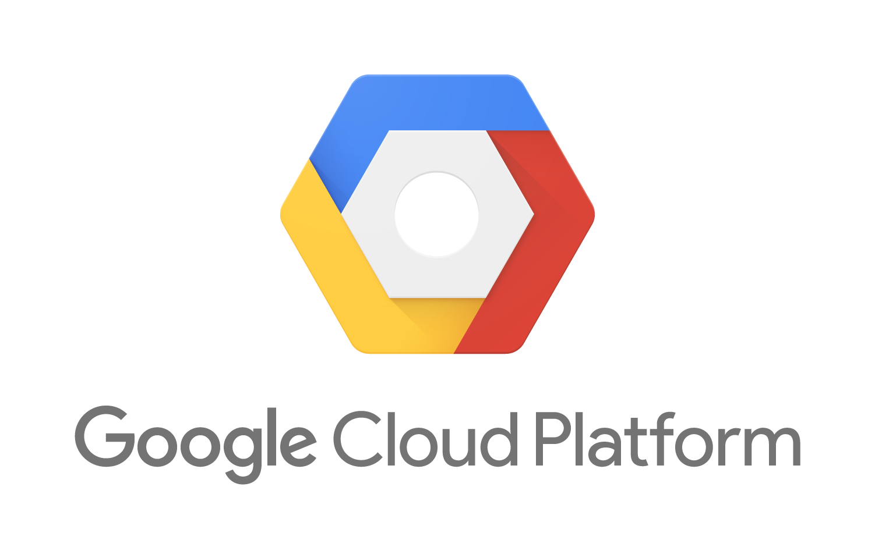
Surabhi Patil, 001251860, patil.sur@husky.neu.edu Amitha_Murali, 001643826, murali.a@husky.neu.edu Jyoti Sharma, 001643410, sharma.j@husky.neu.edu
Network Structure & Cloud Computing
Final Presentation

Slide 2
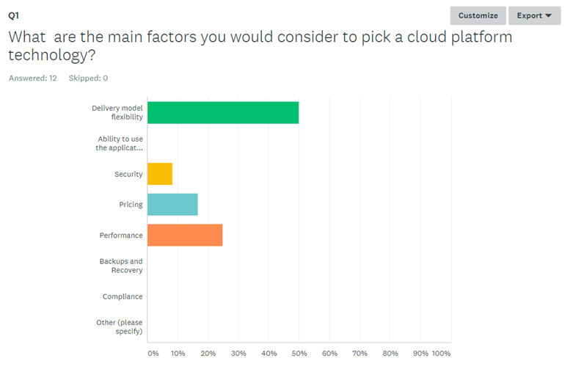
Survey Analysis

Slide 3

The Cloud Wars
Compute & Network
Cloud Security
Storage & Database
Developer & Management Tools
Billing & Pricing
The Verdict

Slide 4
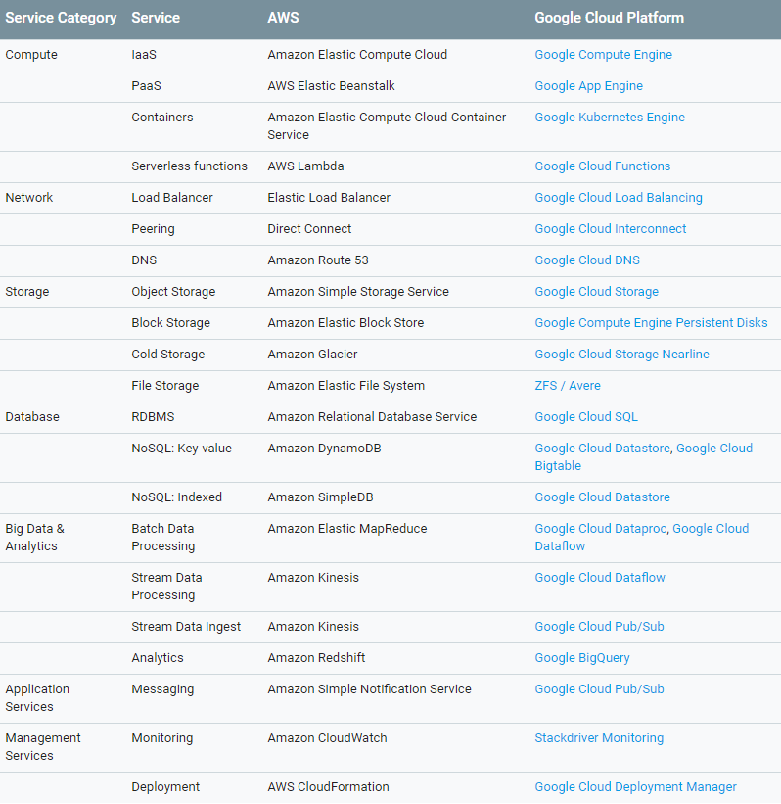

Services Mapping

Slide 5
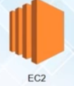
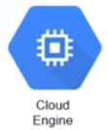

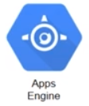
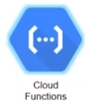

Computing & Network
Option to define your own customized machine on Google Cloud
Google supports live migration of virtual machines
Google supports serial console login
No IP on Load balancer in Amazon, while Google has static IP
No outgoing firewall rules in google firewall
Google subnets can span multiple regions

Slide 6

Cloud Security
All data is encrypted in transit between customers, and data centers by default
The data stored on persistent disks is encrypted under 256-bit AES
Because Google has relationships with some of the biggest ISPs in the world, it helps improve the security of your data in transit as it means less hops across the public internet

Slide 7
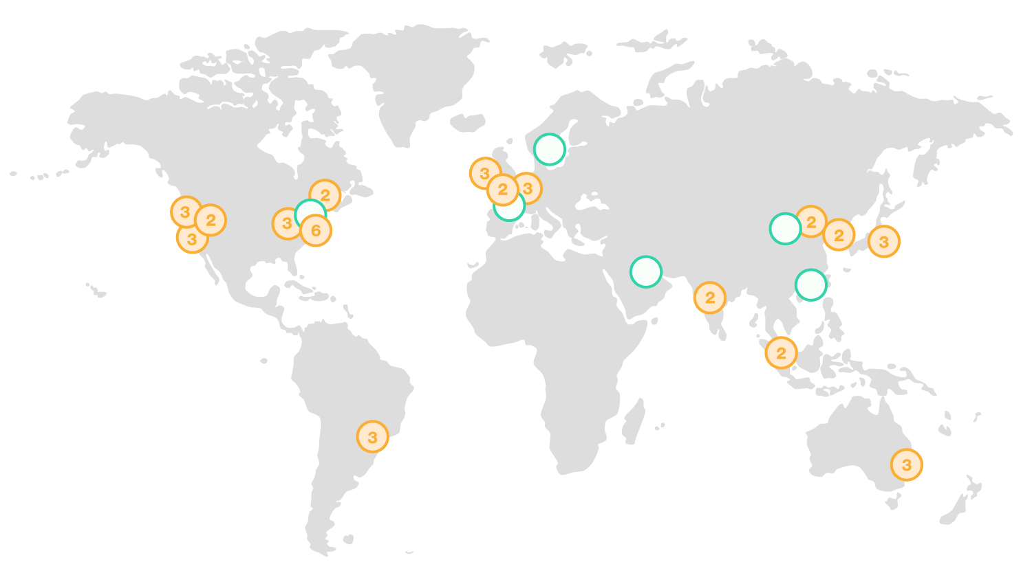
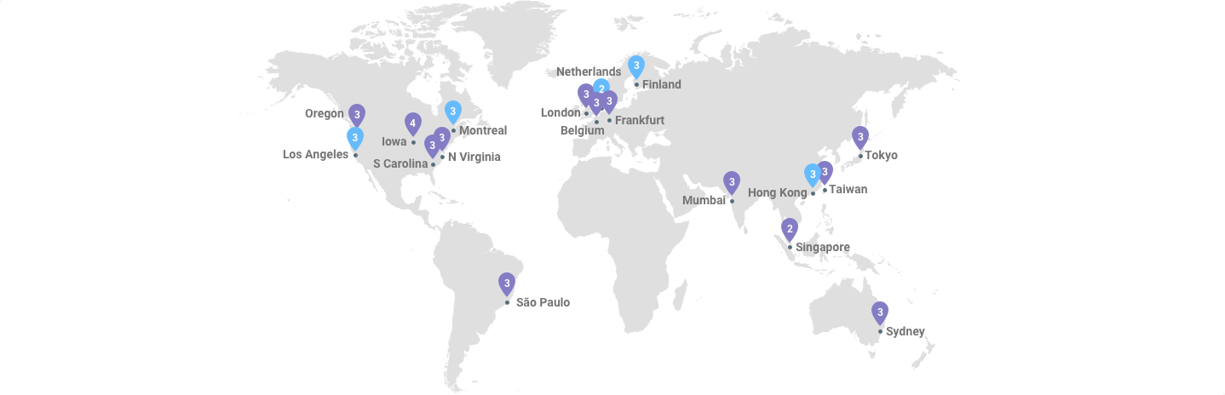
Global Infrastructure

Slide 8
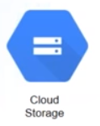
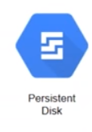
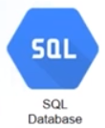

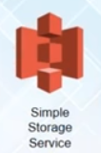


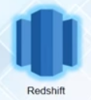
Storage and Database
Google is focused more on NoSQL, while AWS is focused on RDBMS segment
AWS glacier has few hours of latency while Google nearline has few seconds latency
Google Big Query, TPU, Cloud speech are important offerings from Google.
Analytics – Dataproc (lead time 90sec) is better than EMR

Slide 9

Development and Management Tools
AWS CodeCommit
AWS CodeDeploy
AWS CodeBuild
AWS Cloud Watch
Stackdriver
Cloud Deployment Manager
Cloud SDK
Cloud shell
Cloud Deployment Manager

Slide 10
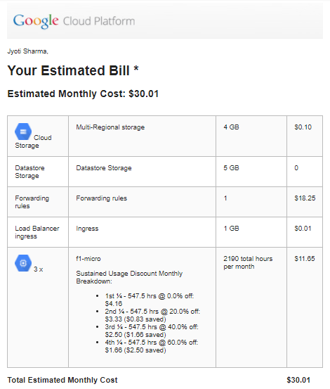

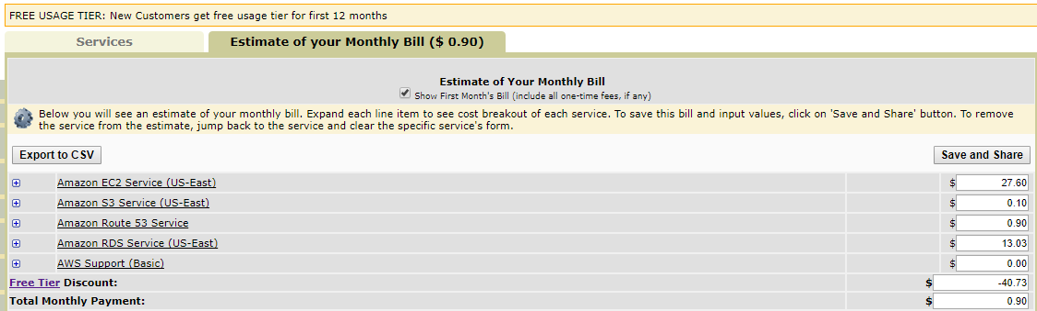
Billing and Pricing
Per second Billing
Committed use discounts vs Reserved Instances
Sustained use discounts
Free trials

Slide 11
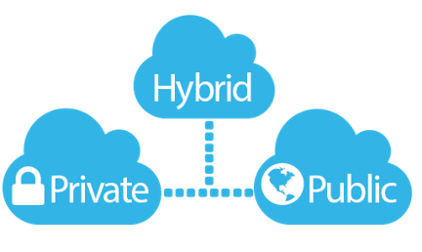
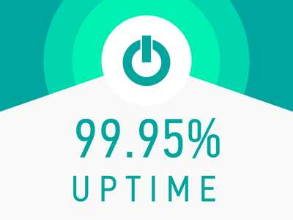
And…
Hybrid Cloud Solutions:
Increase the speed at which they're releasing products and features
Scale applications to meet customer demand
Move applications to the public cloud at their own pace
Reduce time spent on infrastructure and increase time spent on writing code
Reduce cost by improving resource utilization and compute efficiency

Slide 12

Verdict
Google Cloud wins on pricing
AWS wins on market share and offerings
Google Cloud wins on instance configuration
Google Cloud wins on the Big Data and Analytics front.

Slide 13

Better Pricing Than Competitors
Private Global Fiber Network
Live Migration of Virtual Machines
State of the Art Security
Redundant Backups

Slide 14


